Slide 1

Observability Level 1
Seller enablement
Maximize operational resiliency and help ensure the health of cloud-native applications
Addison Goering agoering@us.ibm.com
Senior, Learning Content Development,
Automation Platform
Notes:
IBM has developed the most complete portfolio of observability tools in the industry. These tools operate across a client’s entire hybrid multi-cloud estate, their data pipelines, and business. IBM’s holistic approach emphasizes comprehending and managing the widely distributed hybrid environments of its clients.
These slides and the accompanying speaker notes support sellers in delivering the Observability Level 1 client deck focused on IT observability. This deck is not meant to be client-facing, but some slides may be appropriate for such discussions. Use at your discretion.
If you have any questions on the content that is covered, contact:
Addison Goering: agoering@us.ibm.com, Senior, Learning Content Development, Automation Platform

Slide 2
Seller guidance
and legal disclaimer
Slides in this presentation marked as "IBM
and Business Partner Internal Use Only"
are for IBM and Business Partner use
and should not be shared with clients
or anyone else outside of IBM or the
Business Partners’ company.
© IBM Corporation 2025.
All Rights Reserved.
The information contained in this publication
is provided for informational purposes only.
While efforts were made to verify the completeness and accuracy of the information contained in this publication, it is provided AS IS without warranty
of any kind, express or implied. In addition, this information is based on IBM’s current product
plans and strategy, which are subject to change
by IBM without notice. IBM shall not be responsible
for any damages arising out of the use of, or otherwise related to, this publication or any other materials. Nothing contained in this publication is intended to,
nor shall have the effect of, creating any warranties
or representations from IBM or its suppliers
or licensors, or altering the terms and conditions
of the applicable license agreement governing
the use of IBM software, IBM hardware,
or IBM services.
References in this presentation to IBM products, programs, or services do not imply that they will
be available in all countries in which IBM operates.
Product release dates and/or capabilities referenced
in this presentation may change at any time at IBM’s sole discretion based on market opportunities or
other factors and are not intended to be a commitment
to future product or feature availability in any way. Nothing contained in these materials is intended
to, nor shall have the effect of, stating or implying
that any activities undertaken by you will result
in any specific sales, revenue growth,
or other results.
All client examples described are presented
as illustrations of how those clients have
used IBM products and the results they
may have achieved. Actual environmental
costs and performance characteristics
may vary by client.
IBM and Business Partner
Internal Use Only
Notes:
This self-explanatory slide shares seller guidance and legal disclaimers for this presentation.

Slide 3
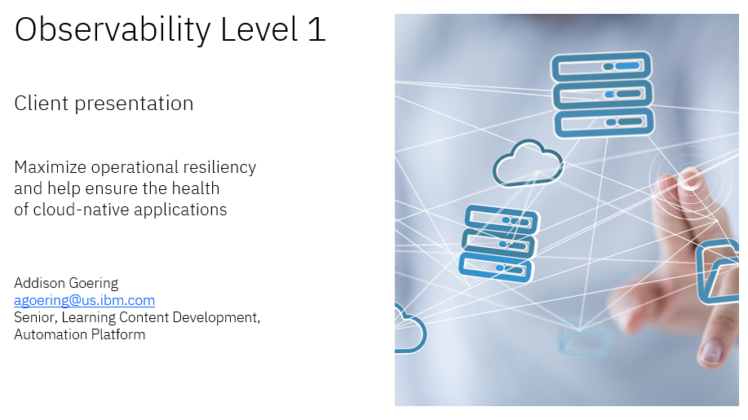
Before you start this seller presentation, review the client presentation
Click here to download the client presentation
Notes:
It is recommended to first review the Observability Level 1 client presentation in Seismic. That presentation provides further details on public-facing content, deeper insights into client interaction, and the enterprise impact of IBM’s observability solutions.
Links:
Observability Level 1 client presentation: https://ibm.seismic.com/Link/Content/DCjbfhWH6cc8C8CP9WddB8djb768

Slide 4

Agenda:
Observability overview and landscape
IT observability
Observability in the Automation platform
Observability product deeper dives
  IBM Concert
  IBM Instana
  IBM Turbonomic
  IBM Cloud Pak for AIOps
  IBM SevOne
  Flexera One
Contacts and resources
Notes:
This seller enablement presentation covers:
Observability overview and landscape
IT observability
Observability in the Automation platform
Observability product deeper dives
IBM Concert
IBM Instana
IBM Turbonomic
IBM Cloud Pak for AIOps
IBM SevOne
Flexera One
Contacts and resources
Terminology:
AIOps: Artificial Intelligence for Operations

Slide 5





What is observability?
“The ability to understand the internal state or condition of a complex system
based solely on knowledge of its external outputs, specifically its telemetry.”¹
Based on the theory of automating the control of dynamic systems
Flow control
system
Flow control
system
Example of a dynamic system: Regulating the flow of water through
a pipe based on feedback from a
flow control system
Notes:
Observability is defined as the ability to understand the internal state or condition of a complex system that is based solely on knowledge of its external outputs, specifically its telemetry. “Observability” comes from control theory, an engineering theory concerned with automating control of dynamic systems, such as regulating the flow of water through a pipe based on feedback from a flow control system. In the example shown on the slide, two flow control valves gather telemetry data. Based on the telemetry data, the valve at the main water source can reduce the flow from the body of water. The other valve can increase the flow to the water spigot (on top to the outside) based on telemetry data. Together, the valves observe and regulate the flow of water from the main source to the spigot.
Translate this simple example to modern, distributed technical stacks. Observability provides deep visibility into modern, distributed tech stacks for automated, real-time problem identification and resolution. The more observable a system, the more quickly and accurately IT teams can shift from an identified performance issue to its root cause, without extra testing or coding.
Resource:
¹ “What is observability?”, IBM, 13 November 2024, https://www.ibm.com/think/topics/observability?mhsrc=ibmsearch_a&mhq=observability

Slide 6
Why do organizations need observability?
The technology landscape is increasingly connected and complex
Insights into system behaviors are crucial
Observability is indispensable
Complexity
10⁹
X
X
10⁵
10³
X
Interconnectivity
X
10²
10
X
1
X
X
Monolithic
business app
Enterprise apps
Departmental apps
SaaS apps
Public and private APIs
Serverless and microservices
App 360°
1970s
1980s
1990s
2000s
2010s
2020+
2024
Notes:
Over the past fifty years, the composition of the IT environment has become more interconnected, complex, dynamic, and sophisticated. The gap between sophistication and the human ability to manage it is widening every year. This interconnectivity and complexity is a management challenge for clients.
As this graph shows, over the past 20 years, the number of “application” layers has grown threefold. Today’s applications can generate millions of transactions a day and change every few seconds. The scale and dynamic nature of distributed hybrid environments is difficult for IT organizations to comprehend and manage.
Observability can help organizations comprehend and manage these widely distributed hybrid environments. However, observability is often confused with application performance monitoring (APM) and network performance management (NPM).
APM tools are effective for monitoring and troubleshooting monolithic applications and traditional, distributed applications. They analyze telemetry relative to key performance indicators (KPIs) and assemble the results in dashboards. These dashboards alert operations and support teams to any abnormal conditions that cause, or threaten to cause, system performance issues.
NPM tools connect with network components and other IT systems to measure, analyze, and report on network topology, performance, and health.
Observability tools are a natural evolution of APM and NPM data collection methods. They are better suited to address the increasingly interconnected, distributed, complex, and dynamic nature of cloud-native application deployments.
Observability doesn’t replace these monitoring approaches. It improves and expands upon them.
Terminology:
API: Application programming interface
App 360⁰: Comprehensive and all-encompassing architectural view of an application
SaaS: Software as a Service

Slide 7



Observability landscape consists of three broad categories
Data observability
Practice of monitoring, managing, and maintaining data
Help ensure quality, availability, and reliability across processes, systems, and pipelines
Identify and troubleshoot data issues in near
real time
Business observability
Practice of capturing, measuring, and managing the interaction between
IT telemetry and business analytics
Aligning key initiatives to the performance of systems, applications, and processes
Helps organizations make informed decisions that impact operations & achieve financial goals
IT observability
Practice of measuring
a system’s current state
Recorded as logs, metrics, and traces
Helps identify and resolve issues
Notes:
The observability landscape is broadly organized as data, business, and IT. The focus of this presentation is IT observability.
As organizations embrace cloud-native technologies, system architectures are more complex and at-scale. Client experiences are more important than ever, and as a result, IT teams face mounting pressure to track and respond to issues faster. To address these challenges, teams are turning to observability solutions so they can proactively identify and resolve issues in their highly distributed and complex computing environments.
Data observability
Data observability is the practice of monitoring, managing, and maintaining data in a way that helps ensure its quality, availability and reliability across various processes, systems, and pipelines within an organization. For clients, data observability is about understanding the health of their data and its state across their data ecosystem. It includes various activities that go beyond traditional monitoring that describes a problem. Data observability can help identify, troubleshoot, and resolve data issues in near real time.
Business observability
Business observability is the real-time monitoring of business processes, operations, and activities. It offers insights into business performance that allow organizations to troubleshoot issues and adapt to business users’ needs. Business observability provides a comprehensive understanding of key business operations. Enterprises can optimize business performance by transforming data into informed business decisions. It prioritizes the analysis of key performance indicators (KPIs) and service level agreements (SLAs) to help teams surface actionable insights from their data.
IT observability
IT observability is the ability to measure a system’s current state based on the data it generates, recorded as logs, metrics, and traces, commonly known in IT as the “three pillars of observability.”
Logs record the details of an event. Metrics capture the measurements that are used to quantify the performance and health of services. Traces track how services connect from end to end in response to requests.

Slide 8

What is data observability?
“The practice of monitoring, managing,
and maintaining data in a way that
ensures its quality, availability and
reliability across various processes,
systems, and pipelines within
an organization.”¹
Notes:
Data observability is the practice of monitoring, managing, and maintaining data in a way that helps ensure its quality, availability, and reliability across various processes, systems and pipelines within an organization.
Data observability is about clients understanding the health of their data and its state across their data ecosystem. It includes various activities that go beyond traditional monitoring, which only describes a problem. Data observability can help identify, troubleshoot, and resolve data issues in near-real time.
Utilizing data observability tools is essential for getting ahead of poor data quality issues, which sit at the heart of data reliability of AI and analytic systems. These tools enable automated monitoring, triage alerting, tracking, comparisons, root cause analysis, logging, data lineage, and service level agreement (SLA) tracking. Working together, these capabilities help practitioners understand end-to-end data quality, including data reliability.
Implementing a data observability solution is especially important for modern data teams, where data is used to gain insights, develop machine learning models and fine tune gen AI models, and drive innovation. Data observability helps ensure that data remains a valuable asset rather than a potential liability.
Data observability needs to be infused consistently throughout the end-to-end data lifecycle. That way, all data management activities that are involved are standardized and centralized across teams for a clear and uninterrupted view of issues and impacts across the organization.
Resource:
¹ “What is data observability?”, IBM, 2025. https://www.ibm.com/think/topics/data-observability

Slide 9
Why does data observability matter?
82%
of organizations say that data quality concerns are a barrier to data integration projects¹
Most organizations believe
that their data is unreliable
80%
of executives do not trust their data²
Notes:
Traditionally, it is difficult to identify bad data until it’s too late. Unlike when an application goes down and it affects thousands of users immediately, businesses can operate on bad data unknowingly for quite some time. For example, a sales team knows right away if a Salesforce dashboard isn’t loading, but there’s no telling how long it would take them to figure out that a dashboard is showing incorrect data!
Data observability is the best defense against bad data getting through to users. It monitors data pipelines to help ensure complete, accurate, and timely delivery of data so that data teams can prevent data downtime, meet data service level agreements (SLAs), and maintain the business’s trust in the data it sees.
Resources:
¹ “Data Integrity Trends: Chief Data Officer Perspectives in 2021”, Precisely, June 2021. https://www.precisely.com/app/uploads/2021/06/Data-Integrity-Trends-2021-Corinium-Intelligence.pdf
² “The data-powered enterprise: Why organizations must strengthen their data mastery”, Capgemini Research Institute, February 2021. https://www.capgemini.com/wp-content/uploads/2021/02/Data-powered-enterprise_Digital_Report-4.pdf

Slide 10

What is business observability?
The practice of capturing,
measuring, and managing
the interaction between IT
telemetry & business analytics
Notes:
Where IT and data observability tend to focus on observing the technical aspects of an organization, business observability places the focus on the interaction between telemetry data and business outcomes.
Business observability should have clear and measurable business objectives. This helps ensure that the focus is on aspects that are directly related to achieving those objectives and mitigating possible risks.
An important part of business observability is understanding how much of the technology stack is instrumented and monitored. Measuring the percentage of telemetry data captured from all sources across the entire business is known as telemetry data coverage, which is a key business observability metric. It helps gauge how much of a client’s systems, applications, and processes are monitored and the amount of data available for analysis.
Understanding telemetry coverage ultimately leads to measuring the real-time financial impact of performance issues, technology outages, and resource allocations. Understanding the financial impact of different metrics can help organizations prioritize their efforts to improve the performance of critical systems and services. This knowledge can help organizations make data-driven decisions about investments in new technology and infrastructure.

Slide 11
Why does business observability matter?
Only 37%
Enables a business to gain
real-time insights & proactively
manage the performance and
health of the organization
of organizations say that their telemetry
data includes business context to quantify
the business impact of events and incidents.¹
Notes:
Many organizations are not able to quantify the relationship between their telemetry data and the business. This disconnect is often due to a lack of visibility and data silos between technology, finance, and business teams. Connecting the dots back to the business after the fact can be difficult and reactive, resulting in obsolete, non-actionable insights. It shouldn’t be an afterthought.
Business observability can help reduce or eliminate data silos by actively aligning monetary costs and revenue impacts to the performance of systems, applications, and processes. When organizations implement business observability practices, they get visibility into how their applications and infrastructure impact their business so they can make data-driven decisions and achieve financial gains.
Data-driven business decisions can impact the business with:
Enhanced business performance by identifying bottlenecks and inefficiencies that may be impacting revenue generation, customer satisfaction, or operational costs.
Proactive, real-time risk assessment and management by detecting anomalies and potential issues in real time and proactively mitigating risks before they escalate. This can help prevent costly outages, service disruptions, and customer dissatisfaction, as well as safeguard the organization’s reputation and financial health.
Optimized customer experience from monitoring the entire customer journey to gain deep insights into customer behavior and preferences. This leads to strategies that enhance the customer experience, which can lead to increased customer loyalty.
Accelerate innovation by identifying opportunities and acting quickly, which can lead to new product development, services, or business models that drive growth and market differentiation.
Resource:
¹ “6 Steps to Achieve Business Observability”, New Relic, June 2023. https://newrelic.com/sites/default/files/2023-06/new-relic-six-steps-to-achieve-business-observability-2023-06-23.pdf

Slide 12
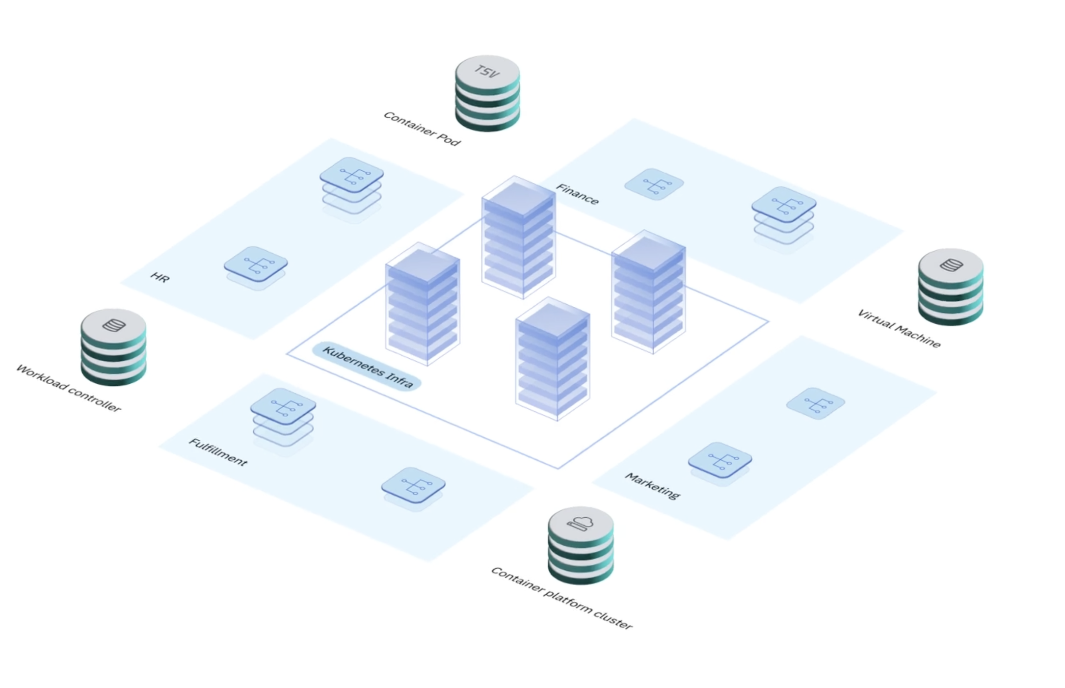
What is IT observability?
IT observability is a comprehensive strategy
to simplify complex IT estates with deep visibility
into modern, distributed applications, root cause
analysis of performance and risk issues to boost performance and help maximize operational resilience.
Notes:
IT observability, the focus of this presentation, offers a comprehensive strategy and common language that allows developers and operations teams to gain insights into the same system behaviors and crucial key performance indicators for a business. This shared understanding facilitates collaborative troubleshooting and faster resolution of issues.
Developers can instrument their code by incorporating appropriate monitoring and observability mechanisms. This involves strategically placing code-level instrumentation points and logging statements throughout the application. By doing so, developers enable the collection of valuable data and insights during the runtime of their software.
Observability allows operations teams to monitor system metrics and set up alerts for abnormal behavior. For example, they can monitor CPU usage, memory usage, and network traffic to detect performance spikes or resource bottlenecks. Using real-time monitoring and visualization tools, operations teams can track the health of distributed systems and detect anomalies or failures. They can identify the impact of specific events on system behavior and respond promptly to mitigate any issues.

Slide 13





How does IT observability help business?
Identify and resolve issues early in development
Improve the
user experience
Automate remediation and self-healing of application infrastructure
Minimize downtime
and MTTR
Discover and address “unknown unknowns”
Notes:
Full-stack observability can make a system easier to understand and monitor, easier and safer to update with new code, and easier to repair.
A main limitation of monitoring tools is that they watch for “known unknowns”, which are exception conditions that IT teams already know to watch for. In contrast, observability tools discover conditions teams might never know or think to look for. Observability tools track their relationship to specific performance issues. Thes insights provide greater context to help identify root causes and accelerate resolution.
Observability integrates monitoring into the early phases of the software development process. This integration helps DevOps teams identify and fix issues in new code before they impact the client experience or service level agreements (SLAs).
Observability tools enable developers to collect, analyze, correlate, and discover a broad range of telemetry data to better understand user behavior and optimize the user experience. For instance, observability tools enable teams to specify instrumentation and data aggregation in a Kubernetes cluster configuration and gather telemetry from the moment it spins up until it spins down.
IT teams can combine observability with AIOps, machine learning (ML), and automation capabilities to predict issues based on system outputs and resolve them without human intervention. This helps accelerate the issue discovery and resolution processes. This acceleration helps teams keep application availability high, mean time to resolve (MTTR) low, and outages to a minimum.

Slide 14
IT observability
Notes:
This section provides sellers a general overview of IT observability.

Slide 15
Monitoring and Observability
Application Performance
Monitoring (APM) Tools
Effectively used by IT teams for monitoring
and troubleshooting monolithic & traditionally
distributed applications
Observability Tools
Digital transformation with a shift to cloud-native technologies and reliance on microservices
IT teams need the fine-grained, high-volume,
automated telemetry, and real-time insight
generation that observability tools provide
10⁹
X
X
10⁵
10³
X
X
10²
10
X
1
X
X
Monolithic
business app
Enterprise apps
Departmental apps
SaaS apps
Public and private APIs
Serverless and microservices
App 360°
1970s
1980s
1990s
2000s
2010s
2020+
2024
Notes:
For the past few decades, IT teams have relied primarily on application performance monitoring (APM) tools to monitor and troubleshoot applications. APM tools periodically sample and aggregate application and system data that can help identify application performance issues.
Specifically, APM tools analyze telemetry relative to key performance indicators (KPIs) and assemble the results in dashboards that alert operations and support teams to any abnormal conditions causing or threatening to cause system performance issues.
APM tools are effective for monitoring and troubleshooting monolithic apps and traditional, distributed applications. In these configurations, new code releases occur periodically. Workflows and dependencies between application components, servers, and related resources are well-known or relatively easy to trace.
Monitoring, which focuses on collecting metrics and data, provides valuable information about the health of systems. Yet, it lacks the granularity and real-time capabilities that observability brings. Monitoring tools might alert when a threshold is breached, but observability offers a holistic view, enabling clients to understand why and pinpoint where issues arise.
Today, organizations are embracing digital transformation. They’re rapidly shifting toward modern development practices, such as agile development, continuous integration and continuous deployment (CI/CD), DevOps, and adopting cloud-native technologies, such as containers and serverless functions.
Modern applications often rely on microservices architectures, often running within containerized Kubernetes clusters. As a result, developers can bring more services to market faster than ever. But, in doing so, they deploy new application components, often at overwhelming numbers, throughout the architecture. These components are developed using different programming languages, and operate using different runtimes and data formats. For example, with serverless functions, the duration is sometimes only for seconds or fractions of a second, and then goes away. That means multiple runtimes, with each runtime outputting logs in different locations within the architecture making things very complex.
Many APM tools sample data once per minute, using traditional monitoring protocols that can’t keep pace with the immense amount of data generated by modern applications. Instead, businesses need the fine-grained, high-volume, automated telemetry and real-time insight generation that observability tools provide. These tools enable development teams to create and store real-time, high-fidelity, context-rich, fully-correlated records of every application, user request, and data transaction on the network.
Terminology:
API: Application programming interface
App 360⁰: Comprehensive and all-encompassing architectural view of an application
SaaS: Software as a Service

Slide 16



Continuous discovery and collection of telemetry data
Logs
Granular time-stamped, complete, and immutable records of application events
Can be used to create
a high-fidelity, millisecond-by-millisecond record of every event with context
Used for troubleshooting and debugging
Traces
Record of the end-to-end journey of every user request
From the user interface or app, through the entire architecture,
and back to the user
Metrics
Measures of application and system health
over time
Sometimes referred to as “time series metrics”
Notes:
As shown on this slide, there are three types of telemetry data: logs, traces, and metrics.
Logs
Log files (logs) contain information about the operations, activities, and usage patterns of an application, server, or IT system. They include a historical record of all processes, events, and messages along with more descriptive data, such as timestamps, to contextualize this information. Timestamps show when something happened.
Logs provide a detailed and easily accessible record of system information that would otherwise be difficult to collate. They provide insight into the performance and compliance of applications and systems. Log files are crucial for cloud applications because of their dynamic and distributed features. Log files include event logs, system logs, access logs, server logs, change logs, and other logs.
Cloud-native applications often have serverless or microservices architectures. They are made of several independent software components that constantly communicate with each other for normal system functioning. It can be difficult to troubleshoot issues without access to these communication logs.
Specifically, log files provide:
Insight into the overall well-being and functionality of systems
An incident timeline for faster troubleshooting
Information to identify security bugs and minimize security risks
Information to optimize application performance
Traces
Tracing encompasses a wide, continuous view of an application. The goal of tracing is to follow a program’s flow and data progression. In many instances, tracing represents a single user’s journey through an entire application stack, literally from a button tap on a mobile phone all the way to the back-end logic performing the action. By tracing through a stack, developers can identify bottlenecks and focus on improving performance.
In the case of distributed, modern applications, a trace is defined as a collection of spans. A span is the smallest unit in a trace and represents a piece of the workflow in a distributed landscape. Like a hypertext transfer protocol (HTTP) request, database call, or some type of operation taking place on a service.
When a problem occurs, a trace, which is a collection of spans, shows:
Functions involved
Duration of one or more functions
Parameters passed
How deep into the functions the user got
Metrics
The purpose of metrics is to inform observers about the health and operations of a component or system. A metric represents a point in time measurement of a particular resource, and data-wise it tends to be small. Its compact size allows for efficient collection even at scale in large systems. Metrics also lend themselves to pre-aggregation within the component before collection, reducing computation costs for processing and storing large numbers of metric time series in a central system. Due to how efficiently metrics are processed and stored, they lend themselves well for use in automated alerting. Metrics are an excellent source indicator for the health data of all components in the system.

Slide 17


How do observability tools work?
Data collection
Continuous data collection makes observability possible
Observability tools
facilitate the collection
and aggregation of:
  CPU memory data
  App logs
  Average latency
  Other metrics
Monitoring
Teams can view application and system data through dashboards
Dashboards are used
to monitor application health, related services,
and relevant business objectives
Analysis
Observability tools compile data from multiple sources, finds what is pertinent, and delivers actionable insights to development teams
Automates three key
processes to help
businesses understand
their technology stacks
from telemetry data
Notes:
Observability tools typically automate three key processes to help businesses understand their tech stacks more clearly: data collection, monitoring, and analysis.
Continuous data collection makes observability possible. Observability tools facilitate the collection and aggregation of, and access to, memory data, app logs, average latency, and other metrics.
Teams must be able to view application and system data with relative ease, so observability tools provide dashboards to monitor application health, related services, and relevant business objectives. Monitoring features also help clarify how services work with each other and fit into the overall architecture by using tools like dependency graphs.
Because modern architectures often rely on containerized microservices, observability tools often offload basic telemetry to the Kubernetes layer, enabling IT teams to focus data analysis on service level objectives (SLOs) and service level indicators (SLIs). Observability software compiles data from multiple sources, analyzes it to find what’s pertinent, and delivers actionable insights back to development teams.
It's worth noting that the automation capabilities of observability software extend beyond these three key processes. Observability tools can also automate debugging processes, instrumentation, agent management, and dashboard updates as new services are added to the network.
Terminology:
CPU: Central Processing Unit

Slide 18
Observability in the Automation platform
Notes:
This section discusses how sellers can position observability in IBM’s IT Automation platform.

Slide 19




Automation
Automate technology lifecycle management with AI for productivity, resiliency, and spend optimization
Application Development
and Integration
Infrastructure
Automation
Technology Business
Management
Connect teams, data, and technology to modernize, innovate, and automate systems and applications
for faster, more efficient development at scale
Unlock developer productivity and lessen the risk of breaches for more resilient and secure infrastructure and faster time
to market with AI-enhanced capabilities
Reduce cloud waste,application risk, gain visibility of IT spend,
and proactively resolve issues for better uptime and user experiences with AI-enhanced capabilities
Application Development
Application Integration
Infrastructure Lifecycle
Management
Identity and Access
Management
Network Management
Observability
FinOps
IT Financial Management
Asset Lifecycle Management
Notes:
The technology business management (TBM) layer is based on a framework that helps clients improve business outcomes by giving them a consistent way to translate technology investments to business value. IBM’s offerings in the TBM layer are aligned across four more layers: Observability, FinOps, IT Financial Management (ITFM), and Asset Lifecycle Management​ (ALM). Each layer contributes to IBM’s overall TBM messaging and positioning.
Reference:
“What is TBM?”, TBM Council, 2025, https://www.tbmcouncil.org/learn-tbm/what-is-tbm/.
“What is FinOps?”, FinOps Foundation, 2025, https://www.finops.org/introduction/what-is-finops/.
“What is IT Financial Management (ITFM) and 5 Steps to Adoption”, 7 January 2025, https://www.finout.io/blog/what-is-it-financial-management.
“What is asset lifecycle management?”, IBM, 13 May 2023, https://www.ibm.com/think/topics/asset-lifecycle-management.
Terminology:
FinOps: Finance and DevOps

Slide 20







































Automation
Automate technology lifecycle management with AI for productivity, resiliency and spend optimization
Application Development
and Integration
Infrastructure Automation
Technology Business Management
Connect teams, data, and technology to modernize, innovate, and automate systems and applications for faster, more efficient development at scale
Unlock developer productivity and lessen the risk of breaches for more resilient and secure infrastructure and faster time to market with
AI-enhanced capabilities
Reduce cloud waste, application risk,
gain visibility of IT spend, and proactively resolve issues for better uptime and user experiences with AI-enhanced capabilities
Application
Development
Application
Integration
Infrastructure Lifecycle Management
Identity
& Access Management
Network
Management
Observability
FinOps
IT Financial
Management
Asset Lifecycle Management
Enterprise Application Service for Java
Hybrid iPaaS
Terraform
Verify
NS1
Concert
Cloudability
Apptio
Maximo Application Suite
API Connect
Consul
Hybrid Cloud
Mesh
Instana
Kubecost
Targetprocess
Envizi ESG Suite
Nomad
SevOne
Turbonomic
Environmental Intelligence
Vault
Rapid Network Automation
Notes:
In the observability layer, Concert, Instana, and Turbonomic, individually and collectively, help to proactively remediate issues with AI-enabled full-stack observability and actionable intelligence.​
Terminology:
AIOps: Artificial Intelligence for Operations
API: Application programming interface
ESG: Environmental, social, and governance
iPaaS: Integration Platform as a Service

Slide 21
Observability -
Product deeper dive
IBM Concert
Manage application risk, compliance, and resilience
Notes:
This section discusses IBM Concert features, value proposition, prospecting, and its competition.

Slide 22
IBM Concert
Key features
Discover
Connects with client’s environments and toolsets, uncovering crucial data about an application’s operations
Understand
Uses generative AI to delve into a client’s application architecture, revealing hidden connections, dependencies, and invaluable opportunities
Recommend
Actionable insights from strategic recommendations to enhance an application’s performance and efficiency
Converse
Intuitive conversations using natural language processing (NLP). Question conclusions, comprehend recommendations, and explore the potential impact on application
Act
Take actions based
on recommendations
or automate actions
Notes:
Client applications produce vast amounts of siloed data across disparate tools in their distributed hybrid environments. Concert is the connective tissue across a client’s application landscape. Concert uses this data to generate a 360-degree view of an application that's powered by generative AI.
This siloed data is then analyzed by Concert to gain a more cohesive understanding of business operations at the application level, whether that's risk (like patching an exposure), compliance (like expired certificates), or performance resilience (like ensuring network performance). Concert provides strategic insights and recommendations that are wrapped in the context of client-specific applications and dependencies. Looking at things from a strategic perspective at the application level is how Concert differentiates and uniquely positions itself in the market. Clients can discover the connections, dependencies, gaps, and opportunities in their applications, giving prioritized recommendations for improvement based on the impact to their specific environment.
Using the power of generative AI, Concert goes beyond surface-level analysis to gain a deep understanding of a client’s application architecture. It identifies connections, dependencies, gaps, and opportunities, uncovering insights that may have previously gone unnoticed. By unpacking the intricacies of their architecture, Concert equips businesses with the knowledge that is needed to optimize performance and drive innovation.
Based on the comprehensive understanding of the business application landscape, Concert generates operational and strategic suggestions to enhance client application performance and resilience. These recommendations are beyond the “If/Then” analysis and are tailored to clients’ needs and goals, empowering them to make informed decisions that drive tangible results. Whether clients are optimizing resource allocation or addressing potential vulnerabilities, Concert provides actionable insights that propel an organization forward.
One of the most powerful features of Concert is its ability to engage in natural language interaction. Using conversational interfaces, users can ask questions about a conclusion, seek clarification on recommendations, and gain a deeper understanding of the potential impact on their application. This intuitive interface enhances collaboration and enables stakeholders at all levels to use the insights of Concert effectively.
When clients converse with Concert and figure out the pathway that they want, they can easily act on that information by filing out tickets automatically and populating the chosen path into the ticket integrations for future actions.

Slide 23
IBM Concert
Value proposition
Application vulnerability management
Application compliance management
SSL/TLS certificate
management
Software composition
analysis
Minimize vulnerabilities
and reduce time
to resolution
Remove false positives and duplicates
Prioritize CVE severity with
context to impact
Minimize window
of exposure and minimize compliance work with continuous compliance and deviation control
Minimize application
risk associated with certificates by surfacing compliance risks and incorporating app and infrastructure context
Minimize software supply chain risk
and open-source software tainting
Enable practitioners to address issues
in real time
Notes:
IBM Concert helps solve the following problems for clients:
Siloed data from multiple tools that inhibit a complete, holistic view of applications
Lack of a consistent approach to application resiliency, with different teams that use different tools
Too many common vulnerability exposures (CVEs) and uncertainty as they relate to prioritization
Expired or misconfigured certificates that cause outages, disrupt continuity, and expose security risks, such as man-in-the-middle attacks
Months spent on compliance audits, gathering evidence
Increased licensing and security risks due to managing multiple applications with various open source or third-party libraries, or both
By helping clients solve these problems, IBM Concert brings value to clients in:
Application vulnerability management, by minimizing application security risks and speeding up resolution by eliminating false positives and duplicates, and prioritizing CVE based on impact. Clients save time by eliminating manual scripts and spreadsheets, and become more efficient by prioritizing CVEs promptly based on application impact and receiving actionable recommendations for resolution. To take meaningful and swift action, Concert enables clients to simulate remediation scenarios and visualize the CVE blast radius.
Application compliance management, by streamlining how security standards are managed as applications grow. Clients spend less time navigating compliance controls. Clients improve security by assessing their application’s compliance posture against NIST 800-53, CIS Controls, and other compliance standards; they also prevent downtime by anticipating the compliance impact of development decisions in the pre-deployment stage before it affects users.
SSL/TLS certificate management, by managing certificate renewals in a timely fashion to prevent operational disruption. Concert helps clients ensure smooth operations by preventing downtime and streamlining all tasks associated with the certificate management lifecycle. Clients can prioritize renewals, gain key insights, and automate certificate management to help ensure uninterrupted downtime.
Software composition analysis, by reducing software supply chain risks and open-source software (OSS) tainting in real time.
Terminology:
CIS: Center for Internet Security
NIST: National Institute of Standards and Technology
SSL: Secure Sockets Layer
TLS: Transport Layer Security

Slide 24
IBM Concert
Prospecting
Client challenges
  Trouble identifying critical IT challenges
  and opportunities across siloed
  environments, applications, and toolsets
  Lack of visibility across disparate
  application systems and tools
  Limited knowledge on which application
  issue to prioritize and how to remediate
  Trouble managing various applications
  across different environments
  Looking for a single pane of glass view
  Trouble identifying which issues to resolve
Prospecting questions
  What does your IT application landscape look like today How many tools and environments?
  How do you manage all the tools in your IT estate?
  Do you have a single view or aggregator for all these tools?
  Are you suffering from application data overload?
  Is there a gap in your strategic understanding
  of how your application is managed?
  How do you and your team determine
  which issue to prioritize and how do
  they figure out a pathway to solve it?
  How many CVEs did you manage today?
  How do you prioritize which CVEs to manage?
Notes:
This self-explanatory slide provides a one-page summary that helps sellers with prospecting an IBM Concert opportunity by uncovering client challenges and prospecting questions.
Terminology:
CVE: Common vulnerabilities and exposures

Slide 25




IBM Concert
Competitors: Application vulnerability (CVE use case)
Market leader
with a proprietary, integrated workload protection solution
40% of Fortune 100
Integrated cloud security and risk management
Dynatrace is expanding from performance into security, through
a native integration with Snyk
Snyk security insights are provided as
part of Dynatrace’s vulnerability data
Monitors many parts of IT, including networks and servers
Automatically send alerts for issues
or anomalies
Tenable Nessus
is one of the most
widely deployed vulnerability assessment solutions in the cybersecurity industry
Highest ranked by Forrester Wave Q3,
2023 in vulnerability
risk management
Notes:
As of April 2025, in the short term, IBM Concert competes in market niches, all of which have established competitors and distinct market dynamics. On its own, Concert won’t compete on a feature-by-feature level with most competitors. IBM’s short-term plan is to integrate with market leaders and layer additional app-centric context for AI-driven recommendations and actions.
In the long term, Concert will be a platform solution. It will add new value to existing IBM and third-party tools and promote new paths to market through an integrated solution approach.
Terminology:
Snyk: Scans code, open-source dependencies, container images, and infrastructure as code for known vulnerabilities. It provides actionable insights to prioritize and fix vulnerabilities.

Slide 26




IBM Concert competitors
Competitors: Certificate health and management
AWS Certificate Manager
Market leader
in certificate management
Strong automation capabilities
Comprehensive integrations with relevant third-party toolsets and environments
Significant vendor
in the certificate management market
Focus on APIs
and automation capabilities
Easy to use and basic functionality for standard use cases
Full feature set for certificate management within AWS environments
Automation and integration with other AWS components that drives ease of use
Connections to AWS compliance features
Full feature set
of DNS certificate management within the Cloudflare ecosystem
Integration of DNS certificates with other Cloudflare services
Notes:
The vendors on this slide compete in the certificate management space. Most certificate managers are focused on servers and networks. Sectigo offers management (health and renewal) of certificates across environments. Amazon Web Services (AWS) and Cloudflare offer basic certificate management and issuance.
Concert is not a replacement solution for service provider tools like AWS and Cloudflare. However, Concert can be positioned when a client does not want a large certificate manager. The strength of Concert is the ability to deliver a single pane of glass across existing service providers and certificate management tools. Concert focuses on certificate health, not renewals. It consolidates certificate data with knowledge of a client’s environment and applications, providing more specific context to expiry dates.
Terminology:
API: Application Programming Interface
DNS: Domain Name System

Slide 27
Observability -
Product deeper dive
IBM Instana
Application observability
Notes:
This section discusses IBM Instana features, value proposition, prospecting, and its competition.

Slide 28
IBM Instana
Key features
Automatic and continuous discovery
Instana uses a single Agent per host to automatically and continuously discover all components and deploy sensors that are crafted to monitor 300+ technologies.
No configuration needed
Health knowledge base
For 300+ technologies and sensors, a curated knowledge base of health signatures
is continuously compared against the incoming metrics. Constant proactive automated health monitoring
Performance (KPI) dashboards
KPI dashboards based on industry standards: Request Rate, Error Rate, and Duration (Mean/P50/95/99). Application, Service, and Endpoint Dashboards auto aggregate trace metrics.
No custom reports needed
1-Second granularity
Metrics gathered in high fidelity in 1-second granularity. Every request
is traced automatically, capturing the response
time and context. No sampling or partial traces
Real-time
anomaly detection
Instana uses stream processing to analyze incoming data in real-time, uncovering anomalies and service issues to report incidents nearly instantaneously
Root cause analysis
Automatic detection
of changes, issues, and incidents to drastically decrease the time to investigate the root cause
of every service impact
Notes:
With IBM Instana, clients can accelerate their delivery pipelines because this platform immediately indicates to clients the impact of any code changes while determining the root cause that includes all contributing factors. Instana includes:
Discovery and data collection: Instana uses a single agent per host to automatically and continuously discover all components and deploy sensors that are crafted to monitor each technology. No configuration is necessary.
Knowledge base: Each sensor has a curated knowledge base of health signatures that are evaluated continuously against the incoming metrics and are used to raise issues or incidents depending on user impact. Examples of sensors include Java, MySQL, .NET, and many others.
Performance dashboards: Instana provides performance dashboards based on the ‘golden signals’ Request Rate (Calls per n), Error Rate (Percentage), and Duration (Mean/P50/95/99). Application Perspectives, Service, and Endpoint dashboards that aggregate trace metrics to automatically visualize these key performance indicators (KPIs).
Application and infrastructure monitoring: Instana automatically begins monitoring applications and infrastructure components as they are discovered. With no human intervention, its sensors automatically collect configurations, changes, metrics, and events. Metrics are gathered in high fidelity with 1-second metric granularity. Every request is traced automatically, capturing the response time and context with no sampling or partial traces.
Anomaly detection: Instana uses stream processing to analyze incoming data in real time, uncovering anomalies and service issues to create ‘incidents’ nearly instantaneously.
Root cause analysis: Instana automatically detects changes, issues, and incidents to help clients detect, understand, and investigate the root cause of every service impact.
Terminology:
Mean/P50/95/99: Terms used to describe latency metrics or how long it takes for a system or service to respond to requests. The “P” refers to a percentiles.

Slide 29



IBM Instana
Value proposition
Automation
Automate discovery and configuration
Gain full observability
in dynamic environments with auto-discovery
Trace every request, record all changes, get
1-second granularity metrics with no wasted time, no blind spots,
and accurate monitoring
Context
Turn data into contextual information
Understand all application inter-dependencies to diagnose issues and determine impact
Instana contextualizes
raw data into meaningful information that provides an interactive model of relationships between
all entities in real-time
Intelligent action
Prevent issues with actionable alerting
Proactively detect and remediate issues with
an understanding of contributing factors
Analyze every user request from any perspective to quickly find and resolve every bottleneck
Notes:
As companies transform to modern software development using technologies like microservices, cloud-native, continuous integration and continuous development (CI/CD), DevOps, and other strategies, they find their legacy application performance management (APM) solutions are inadequate to handle the new complexities.
Why Instana? Instana’s observability platform stands on three pillars, as shown on this slide, that automatically loads observability metrics, traces, and events and contextualizes all application, services, and infrastructure inter-dependencies so clients can immediately take intelligent action on any issue.
Automation
Instana’s automatic, full-stack visibility spans the entire monitoring lifecycle. From the single, self-monitoring, and auto-updating agent, to the automatic and continuous discovery, deployment, configuration, and dependency mapping, Instana fills the gaps that many APM tools don’t. With zero-configuration dashboards, alerting, troubleshooting, and remediation, Instana relieves teams from manual and time-consuming processes.
Instana’s sensors automatically collect changes, metrics, and events. A strong differentiator for Instana is its high-fidelity data with 1-second metric granularity, along with the fact that every request is traced automatically. There is no sampling or partial traces. Instana has out-of-the-box key performance indicators (KPIs) based on the ‘golden signals’ (Request Rate, Error Rate, and Latency). Instana uses aggregated trace metrics to automatically visualize these KPIs.
Context
In a world of cloud-native applications, understanding how everything fits together is critical in detecting problems and getting to root-cause analysis to solve them. This includes the infrastructure and the application layer. With Instana, the entire stack is considered, not just a piece of code. From the context of this stack, Instana’s capabilities help clients understand the relationships between different data entities in a microservices architecture. Furthermore, it helps clients understand how every entity in real time connects to every other entity.
Intelligent action
Intelligent action is the third pillar of Instana. Teams can resolve issues faster and optimize application performance with features such as root-cause analysis with correlated alerting and incident reporting, guided troubleshooting, immediate feedback of pipeline and canaries, and unbounded analytics. Instana automatically detects changes, issues, and incidents to help teams detect and investigate the root cause of every service impact.

Slide 30
IBM Instana
Prospecting
Client challenges
Surprise outages and slowdowns with
difficult, lengthy, and costly troubleshooting
Monitoring can’t keep up with the pipeline
Difficult to reproduce production problems
in development and test environments
Monitoring slows down the CI/CD pipeline
SLOs not met or degrading
Team members spend too
much time chasing problems
Prospecting questions
How do you detect problems?
Do you automate root cause analysis?
How do you currently measure
the business impact of outages?
How does your team automate cloud
operation release more frequently?
What percentage of your
applications are you monitoring?
What’s your strategy for monitoring
across multiple clouds?
Notes:
This self-explanatory slide provides a one-page summary that helps sellers with prospecting an IBM Instana opportunity by uncovering client challenges and prospecting questions.
Terminology:
CI/CD: continuous integration and continuous deployment
SLO: Service level objective

Slide 31
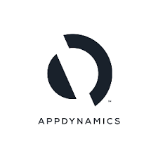
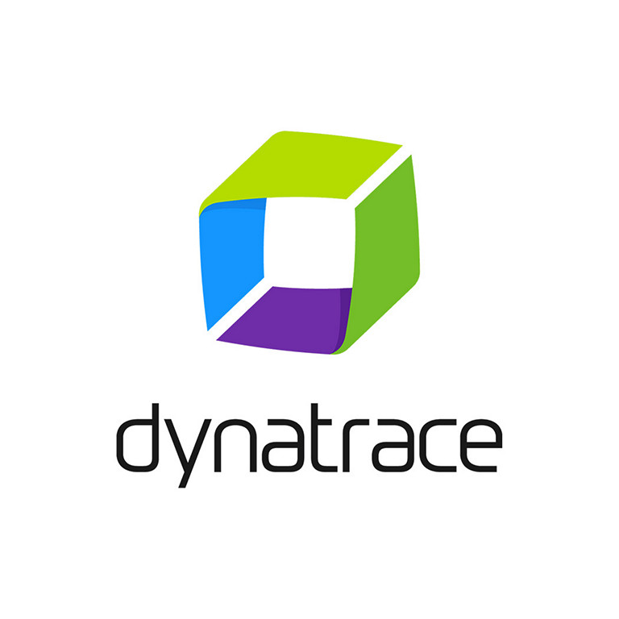
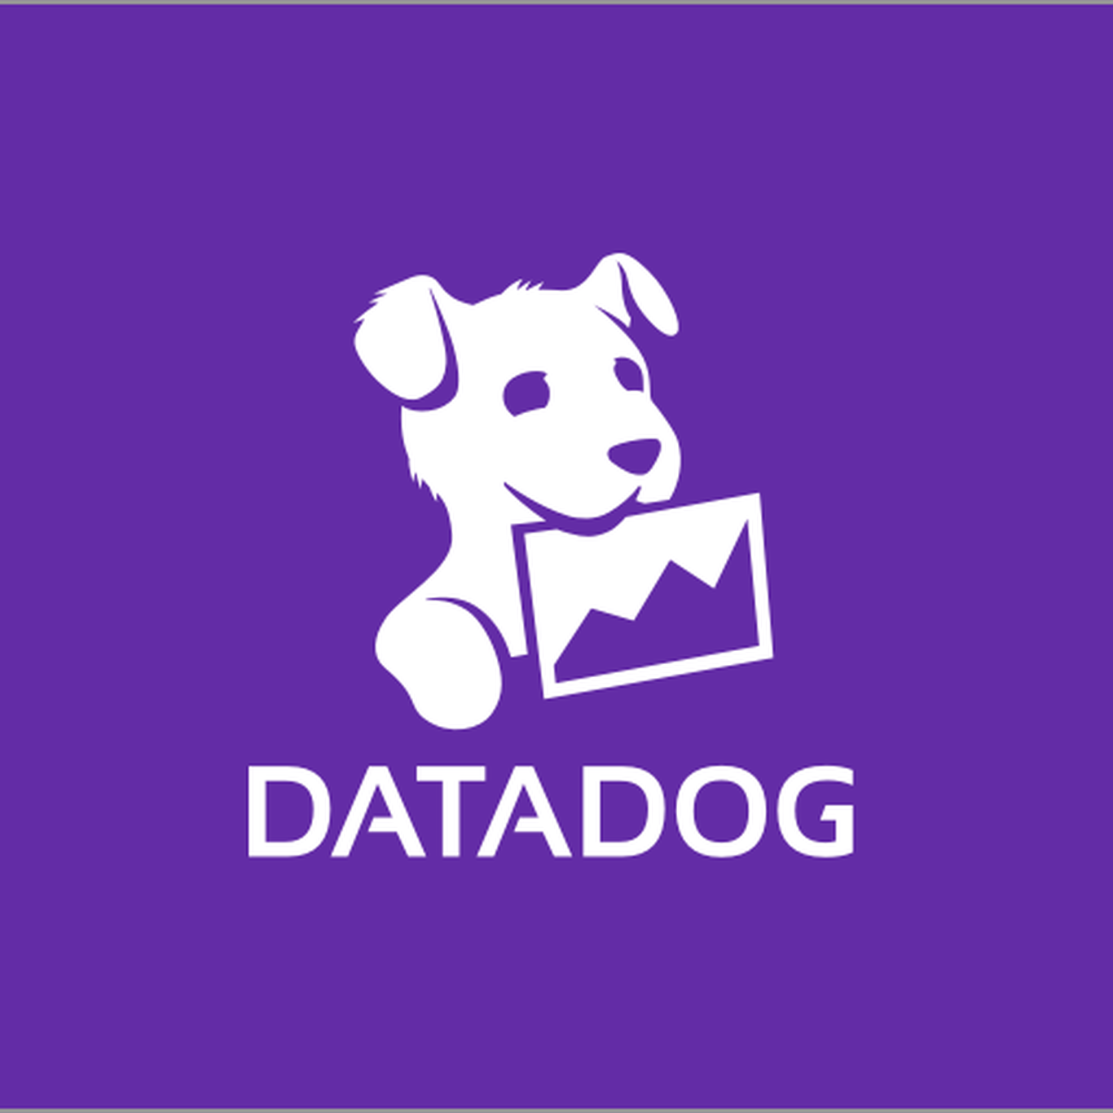
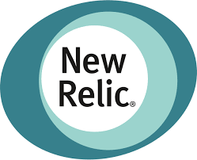

IBM Instana
Competitors
Built for legacy Java workloads that require “method-level instrumentation”
Infrastructure-first
observability approach
Based entirely
on OpenTelemetry
Application-centric,
highly automated
approach
Notes:
IBM Instana has many competitors in the observability space, but this slide shows the four that sellers encounter most frequently.
AppDynamics
AppDynamics is built for legacy Java workloads and monoliths that require method-level instrumentation. AppDynamics is one of the few vendors that still supports method-level timing on traces. Method-level timing is one of the original forms of application instrumentation. AppDynamics was built for monolithic applications, but it has limited use. Over the past decade or so, many clients redesigned their apps into a service-oriented architecture (SOA) or microservices. In these models, services and application programming interface (API) calls are tracked, not methods in the application’s large code base.
Datadog
Datadog is built as an infrastructure-first tool and is a significant name in the market. They rely on metric collection and robust dashboards. Their catalog of integrations and capabilities is extensive and includes:
Application performance management (APM)
End-user management (EUM)
Synthetics
Security
Application lifecycle management (ALM)
Service management
AIOps (AI Operations)
Open-source support
New Relic
Around 2021, New Relic deprecated every proprietary agent and moved to full OpenTelemetry (OTEL). OTEL is an open-source standard for the creation and distribution of data. It is a collection of application programming interfaces (APIs), software development kits (SDKs), and tools. Companies use OTEL to instrument, generate, collect, and export telemetry data (metrics, logs, and traces) to help analyze software performance and behavior.
Dynatrace
Dynatrace is the market leader, according to Gartner, and Instana’s biggest competitor. Dynatrace is considered the most complete solution on the market, and they are hard to compete against. They have an automatic agent, automatic instrumentation, out-of-the-box dashboards, security, logging, tracing, synthetics, and one of the most complete AIOps platforms on the market. Dynatrace has an application-centric viewpoint. Their agent is designed around automation and functions similar to Instana’s agent.
Dynatrace has infrastructure monitoring in addition to user monitoring, synthetics, business analytics, security, AIOps, logging, and an extensive catalog of extensions and integrations. Their user support is strong because Dynatrace started in the APM space in 2005.

Slide 32
Observability -
Product deeper dive
IBM Turbonomic
Application resource management
Notes:
This section discusses IBM Turbonomic features, value proposition, prospecting, and its competition.

Slide 33
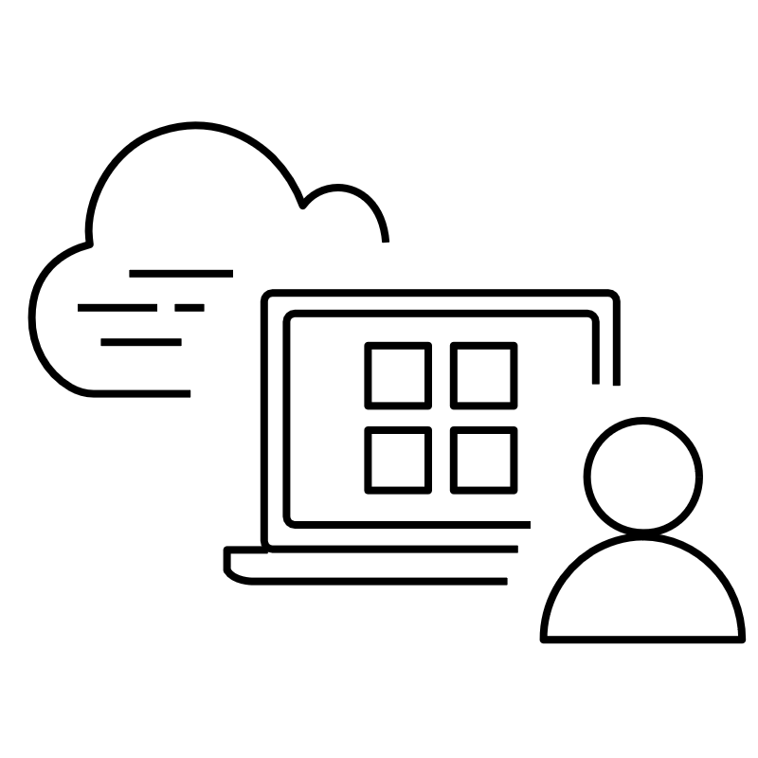


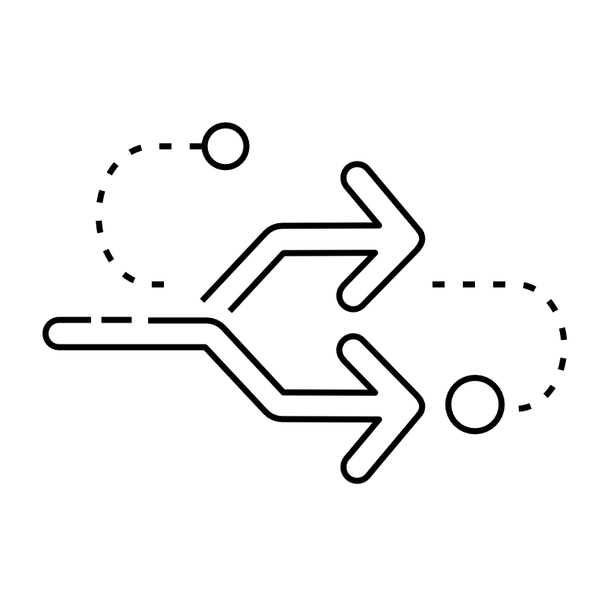
IBM Turbonomic
Key features
Full-stack visualization
AI-powered
insights
Operationalize elasticity
Comprehensive
integrations
Complete visualization of applications and infrastructure to stop guessing and start knowing the health
of an environment
AI-driven insights
that empower teams
to make informed decisions to enhance efficiency without sacrificing performance
Operationalize elasticity to size up or down on demand to assure application performance at the lowest cost
Seamlessly integrate with an organization’s tools, enabling rapid time to value
Notes:
Turbonomic software uses an application-driven, top-down approach to “stitch” together business-critical applications to underlying resources for full-stack visualization. It continuously considers how each entity, such as a virtual machine (VM) or container, works with and impacts every layer, bridging silos for increased collaboration.
An intelligent analytics engine delivers AI-powered insights that drive specific, automatable actions. Applications are dynamically resourced for performance, absorbing peak demands, and adhering to a client’s business policies. Built-in, customizable dashboards offer detailed, real-time scorecards. Turbonomic is preventive, preemptive, and precise.
The Turbonomic platform provides trustworthy actions to meet demand. When clients enable this platform to work proactively on recommended resourcing decisions, they operationalize elasticity by gaining speed and realizing cost savings. Clients automatically mitigate performance risk and reduce cloud waste by using what they need when they need it.
A client’s environment depends on a comprehensive, integrated ecosystem of solutions and technologies to optimize operations. From application management to hypervisors, databases to storage, Turbonomic’s integrations make the work seamless.

Slide 34
IBM Turbonomic
Value proposition
Assure application performance
Intelligent automation proactively identifies bottlenecks, and takes corrective actions to enhance performance
and availability
Optimize IT
resources in real time
Application-aware analytics dynamically optimize resources to help ensure that workloads receive the right amount of workload resources without over
or under-provisioning
Optimize costs
Automate processes and eliminate guesswork in resourcing applications, freeing up IT teams to focus on strategic priorities
Align infrastructure
and application teams
A unified data model aligns infrastructure, application, and DevOps teams around
a single view of application and infrastructure health
Manage hybrid
and multi-cloud
Integrations that are powered by a patented abstraction enable self-optimizing resource management from private data centers to Amazon Web Services, Azure,
and Google Cloud
Integrate
seamlessly
Turbonomic seamlessly integrates with an organization’s existing
tools, enabling rapid
time to value
Notes:
The main value proposition of Turbonomic is to assure application performance at the lowest possible cost. Clients can improve their IT staff productivity by simplifying complex tasks, automating decision-making, and gaining time to innovate. They can optimize their public cloud spend by consuming and paying only for the resources the business really needs, while assuring application performance.
Clients can accelerate and lessen the risk of multicloud projects. Using Turbonomic, clients can safely and efficiently migrate workloads between on-premises and the public cloud to reduce cost and increase efficiency. Without overprovisioning, clients can also safely increase infrastructure utilization while eliminating infrastructure as the cause of application performance degradation.

Slide 35
IBM Turbonomic
Prospecting
Prospecting questions
  How important is it to continuously assure the
  performance of your applications? How do you
  do this today? When do you use these tools?
  Do you sometimes buy a little extra? Pad your
  infrastructure, double the size of your cloud
  instances, or over-allocate?
  What if software could watch everything
  in real-time and make decisions and take
  actions to assure that all applications get
  the resources they need when they need them?
  When a user calls down and says, “my application
  is slow”, what happens next?
  What would it mean if your organization
  could prevent these issues in the first place?
  How many alerts does your team
  ignore on a daily and monthly basis?
Client challenges
  Unable to deliver reliable application
  response time to users
  Overprovisioning to assure app performance
  IT teams spend too much time and
  energy on expensive monitoring
  tools that provide limited insight
  IT teams rely on human oversight
  to make resourcing decisions
  Lack visibility into the resources that
  microservices and containers are using
  Working in siloed teams
  Unable to keep up with the rapid
  growth of cloud-native environment
Notes:
This self-explanatory slide provides a one-page summary that helps sellers with prospecting an IBM Turbonomic opportunity by uncovering client challenges and prospecting questions.

Slide 36




IBM Turbonomic
Competitors
“Business
as Usual”
Application Performance
Monitoring Tools
Cloud Optimization
Tools
Clients fear change
to current processes
VMware Aria
Notes:
Turbonomic faces competition in three areas: “business as usual”, application performance management (APM) tools, and cloud optimization tools.
“Business as usual”
“Business as usual” typically means that the client is not willing to invest in Turbonomic over fear of change to current processes or failure to trust deploying an application resource management (ARM) application. The underlying challenge that these clients face around application resource management and doing nothing will be a negative impact to costs and efficiency. The frustration of the “break then fix” cycle needs to be broken. Sellers can remind clients in this mindset that optimization is not a one-time activity and must be done continuously to unlock the elasticity of their hybrid cloud infrastructure.
Application Performance Monitoring Tools
Datadog is a cloud monitoring and observability platform that monitors applications, infrastructure, and logs. It provides a unified view of the IT stack to quickly identify and resolve performance issues. Datadog clients like that this software monitors applications, infrastructure, log management, and real user monitoring and that it’s scalable for larger enterprise deployments.
Dynatrace is an observability platform that focuses on optimizing cloud environments to deliver improved digital experiences. It gives visibility into applications, infrastructure, and data to resolve performance issues. Dynatrace clients like the fact that it offers unified observability and proactive monitoring.
VMware Aria is a cloud management platform that helps organizations optimize their cloud costs, improve application performance, and simplify cloud operations. It provides a unified view of cloud resources across different cloud providers and on-premises (data center) environments. Clients like Aria’s ability to manage cloud costs, performance, and security for hybrid environments.
Cloud Optimization Tools
Azure offers Azure Advisor to its clients as a solution to optimize their Azure deployments. Advisor offers actionable recommendations to help optimize Azure resources for reliability, security, operational excellence, and cost.
Amazon Web Services (AWS) offers AWS Cost Explorer and Cost Optimization Hub to clients to help manage cloud costs and optimize their cloud resources. Clients can consolidate and prioritize cost optimization recommendations across their AWS accounts and AWS Regions.
Google Cloud offers clients their Recommender service to automatically assess resources hosted on Google Cloud and generate recommendations. Recommendations help to improve workload costs, security, performance, reliability, manageability, and sustainability.

Slide 37
Observability -
Product deeper dive
IBM Cloud Pak for AIOps
Proactive IT operations
Notes:
This section discusses IBM Cloud Pak for AIOps features, value proposition, prospecting, and its competition.
Terminology:
AIOps: Artificial Intelligence for Operations

Slide 38
IBM Cloud Pak for AIOps
Key features
Cross-domain data ingestion and integration
Simplify data configuration
Leverage automation tools
Topology generation
Assembly of unified
IT asset topologies
Visibility into applications
and resources for effective incident pinpointing
Event correlation
and compression
Reduce event overload
Leverage event analytics
Efficient incident management
AI-accelerated operations
Reduce MTTR
Single management console
ChatOps integration
Augmented remediation
Detect anomalies
and establish baselines
Leverage AI models
Accelerate remediation
through Next Best Action recommendations, automated runbooks, and proactive
risk avoidance
Notes:
Cloud Pak for AIOps allows clients to proactively avoid incidents by predicting incidents before they occur with metric-based anomaly detection capabilities. Using its incident feature, clients can react to and resolve incidents quickly. An incident contains information about what occurred, suggested actions to resolve (next best action), and ways to inform critical team members through ChatOps.
Incident triage is done automatically in Cloud Pak for AIOps as incidents are assigned to the correct teams for resolution, and notifications are sent to those teams. The incident triage process accelerates mean time to investigate (MTTI) and starts the resolution process to reduce the time spent on the first step of mean time to resolve (MTTR).
Clients experience this level of information on a single pane of glass because Cloud Pak for AIOps integrates IT tools with over 100 tool connectors like ServiceNow, AppDynamics, among others to view all events, metrics, and other information within a single management console.
Terminology:
AIOps: Artificial Intelligence for Operations

Slide 39





IBM Cloud Pak for AIOps
Value proposition
Contextualize data
Empower organizations
by contextualizing data and providing actionable insights for effective decision-making
Proactive recommendations
Drive faster incident resolution and diagnosis and deliver proactive recommendations based on advanced analytics and machine learning
Collaborative problem solving
Foster teamwork and enhance problem-solving capabilities
by leveraging collaborative features that enable seamless collaboration and knowledge sharing among teams
Automate provisioning
Streamline operations
and save time with automated provisioning capabilities, enabling efficient resource allocation and management
Flexible deployments
Benefit from the flexibility of multiple deployment options, allowing organizations to choose the environment that best suits their needs, whether on-premises, cloud, or hybrid
Notes:
In today’s competitive environment, a few minutes of downtime or an IT outage can cost a business millions in lost revenue, reputational damage, or regulatory penalties. Understanding what is happening across multiple clouds and on-premises environments is becoming more difficult with the proliferation of compartmentalized tools and data silos. Enterprises need to detect IT incidents quickly and resolve them faster.
IBM Cloud Pak for AIOps empowers IT operations teams with insights into incidents and outages by using explainable AI to provide clear recommendations and answer the critical question “What happened”? IBM Cloud Pak for AIOps transforms the way IT operations triage and resolve incidents that lead to improved business outcomes.
Terminology:
AIOps: Artificial Intelligence for Operations

Slide 40
IBM Cloud Pak for AIOps
Prospecting
Client challenges
Too many events to handle within the IT team
Slow response and resolution times for incidents
Siloed, disparate IT tools
Limited visibility into IT incidents
Prospecting questions
On a scale from 1-10, how
complex is your IT environment?
How do you manage all the tools in your IT estate?
When you experience an outage, what
is the first thing you look at to assess it?
How many applications do you
have in your environment today?
What does your IT architecture look like today?
On average, how long does it take you
to resolve an incident?
On average, how many incidents do you
experience each day?
Notes:
This self-explanatory slide provides a one-page summary that helps sellers with prospecting an IBM Cloud Pak for AIOps opportunity by uncovering client challenges and prospecting questions.
Terminology:
AIOps: Artificial Intelligence for Operations

Slide 41




IBM Cloud Pak for AIOps
Competitors
Products used for automation, service management, DevOps, workflow orchestration, AIOps, and security
Correlates related alerts
into incidents using time,
topology, context, and
alerting types
Observability with alert
grouping, metric anomaly
detection, log analytics,
and predictive log analytics
Observability tools for applications that include tracing, performance
metrics, topology, and
alert threshold
configuration
Notes:
BMC
BMC’s key offerings (TrueSight Integration, Helix Discovery, Helix Operations Management with AIOps, and Helix ITSM) can be deployed on-premises and software as a service (SaaS). Their product strengths include:
Automated client noise reduction and intelligent anomaly detection
AI and ML-driven event correlation and root cause isolation
Performance monitoring and event management capabilities
Integrated portfolio for service lifecycle management
BigPanda
BigPanda has a clear and simple marketing message that highlights an innovative approach to alert and event enrichment through tagging. Their software as a service (SaaS) delivery model provides an easy entry point for clients. They include over 30 integrations and custom alert integrations can be built with their user interface (UI)-based integration tool. Modules include monitoring integrations, event normalization, event deduplication, event filtering, event enrichment, and event aggregation.
Service Now
Service Now offers four IT operations management (ITOM) packages: Visibility, Discovery, Health, and Health Log Analytics. They have an offering called Cloud Observability that is fully integrated with ServiceNow workflows. This integration is compelling for legacy clients with cloud-native apps who want to have the user experience of their existing ServiceNow platform.
Splunk
Splunk is available as a SaaS platform, Splunk Cloud Platform, or on-premises through Splunk Enterprise (also available in SaaS). Splunk offers observability tools for applications that include tracing, performance metrics, service mapping (topology), and alert threshold configuration. Similar to the IBM AIOps platform, Splunk includes infrastructure observers for all major public cloud providers, Kubernetes, and Red Hat OpenShift. Splunk has a library of network, metrics, IT service management (ITSM), and other tooling connectors for events, metrics, and logs.
Terminology:
AIOps: Artificial Intelligence for Operations

Slide 42
Observability -
Product deeper dive
IBM SevOne
Automated, application-centric network visibility
Notes:
This section discusses IBM SevOne features, value proposition, prospecting, and its competition.

Slide 43
IBM SevOne
Key features
Complete network visibility
250+ vendors supported for metrics and flow data for application context
API- based self-service data ingestion
Innovative architecture that collects billions of data points per day
Machine learning analytics
Out-of-the-box alert policies with standard deviation analysis
Dynamic capacity
and trend analysis
for future traffic
Advanced visualization
Dashboards and troubleshooting
workflows that are shareable across
teams for operational
consistency
Pivot between metrics, flow, and Splunk/ELK
log data in the
same dashboard
Visualize third-party
data into a customizable reporting layer
Automated actions
Automate tasks and processes with drag-
and-drop low-code development engine
1000+ low-code
building blocks
to facilitate
network automation
Network automation workflow templates
Secure API, abstraction, webhooks, and streaming metrics to accelerate
IT integration
Notes:
Getting the most out of network performance management (NPM) investment starts with collecting 100% of metric and flow collection. SevOne does not set limits on how much can be collected. With SevOne’s self-service data ingestion and innovative architecture, users can collect as much data as needed to accomplish their business goals.
In today’s modern networks it is nearly impossible to look at every variable in the network and know what is normal and what is not. IBM SevOne uses machine learning analytics to automatically baseline every metric based on the time of day and day of week. SevOne builds a baseline that automatically knows whether something is not normal.
IBM SevOne has a series of auto-populating reports for common network performance reporting needs. Users can edit any of the out-of-the-box reports or create new reports for reuse in different regions or offices. This saves clients hours of report building, while enabling consistent insights across multi-site operations teams.
Clients reduce repetitive tasks through automation with 1000s of building blocks for platforms spanning applications, security, automation, infrastructure, performance, cloud, and information technology service management (ITSM). Clients also leverage self-service API-based data ingestion.
Terminology:
API: Application programming interface
ELK: Elasticsearch, Kibana, and Logstash

Slide 44
IBM SevOne
Value proposition
Operationalize performance
data with application context
Higher performance and availability
Lower MTTR and MTTI
Proactive troubleshooting
SLA and compliance reporting
Closed-loop automation
Address business-critical use cases
Lower total cost of ownership
versus existing
Improved client retention
Tools consolidation
Faster service implementations
Helps ensure coverage
Notes:
IBM SevOne provides application-centric, hybrid network observability that turns insights into actions to help NetOps proactively spot, address, and prevent network performance issues. With machine learning (ML) powered analytics from a single source, the solution delivers a comprehensive view of what’s happening in a hybrid cloud network and how that can affect the performance of applications. Clients can optimize their modern network and meet their organization’s agility, reliability, and business efficiency needs with application-centric insights and automation.
Terminology:
MTTI: Mean time to identify
MTTR: Mean time to repair
SLA: Service level agreement

Slide 45
IBM SevOne
Prospecting
Client challenges
Knowing what is normal and what is not
Too many tools and can’t trust data
Need to reduce mean time to resolution
Need to predict and prevent
issues before they impact users
Reduce complexity in the environment
Increase technical and operational agility
to speed up new service delivery
Lack of visibility into dynamic
converged environments
Timely support of new network devices
Reduce time to market for new services
Prospecting questions
How do you troubleshoot a network outage?
Do you trend network performance?
Do you feel that you are overspending on bandwidth?
If you could consolidate products and not lose
functionality, would that ROI from consolidation
be well received by your business managers?
Are you able to get a baseline of raw data?
How are you using your current NPM tools?
Notes:
This self-explanatory slide provides a one-page summary that helps sellers with prospecting an IBM SevOne opportunity by covering client challenges and prospecting questions.
Terminology:
NPM: Network performance management
ROI: Return on investment

Slide 46


IBM SevOne
Competitors
Connects with and correlates NetFlow, configuration, virtual, server, and application data
to diagnose and resolve complex hybrid network performance issues
Monitors WAN and SD-WAN
networks with comprehensive
network monitoring software
to ensure site availability and
policy-defined application delivery
Notes:
Solarwinds connects with and correlates NetFlow, configuration, virtual, server, and application data to diagnose and resolve complex hybrid network performance issues. Solarwinds is packaged with proprietary tools PerfStack, NetPath, and Orion Maps that allow users to gain insights from correlated data historically and in real time. Solarwinds leverages the Orion Platform's modular structure to see all events and alerts on a client’s network in one view and troubleshoot advanced devices across the platform. They deliver central visibility and control through a tightly integrated experience.
Broadcom monitors WAN and SD-WAN networks with comprehensive network monitoring software to ensure site availability and policy-defined application delivery. Their software helps to reduce mean time to repair (MTTR) with automated network monitoring tool triage using algorithmic noise reduction, anomaly detection and application-centric root cause topology insights. Broadcom can predict network congestion with silicon insights using their industry-first network monitoring software for edge networking, IoT, 5G, and private cloud data centers powered by Broadcom Silicon and Broadview Telemetry.
Terminology:
IoT: Internet of things
SD-WAN: Software-defined wide area network
WAN: Wide area network
5G: Fifth-generation cellular network technology

Slide 47
Observability -
Product deeper dive
Flexera One
Comprehensive IT asset management
Notes:
This section discusses Flexera One features, value proposition, and prospecting.

Slide 48
Flexera One
Key features
Gain full visibility
Gain visibility, efficiency, and effective license management by using
a modern SaaS application
Automated licensing processes
Automate IBM license reconciliation for Passport Advantage compliance
Continuous estate updates
Keep the IT estate current
with continuous updates
Streamline compliance reporting
Simplify compliance reporting across the estate with a single pane of glass, including IBM license compliance reporting, peak and current consumption
Expand vendor updates with ease
As the estate evolves, clients
can rest assured that the ease of update for IBM can be expanded to other vendors
Notes:
Flexera One is a powerful tool for managing software licenses. By automating the process and providing a vast library of use rights and templates, it can significantly reduce the time and effort required to maintain an accurate license position. This can be especially beneficial for large enterprises dealing with complex licensing agreements from major vendors like Microsoft, Oracle, and so forth.
Flexera One provides comprehensive software asset management (SAM) capabilities for IBM clients. It helps organizations optimize their software usage and ensure compliance with licensing terms. Organizations can gain real-time visibility into their software usage and reduce their software spend by avoiding unnecessary license purchases. Clients gain visibility, efficiency, and effective license management through a modern software as a service (SaaS) application.
Clients keep well-informed of their IT estate with continuous updates and streamline their compliance reporting across the estate with a single pane of glass. Reporting includes out-of-the-box IBM license compliance, peak consumption, and current consumption. As the technology estates of clients evolve, they can be assured that the ease of update for IBM can be expanded to other vendors.

Slide 49




Flexera One
Value proposition
Optimize IT asset investments
Get the most value
from sprawling deployments of software, hardware,
and SaaS
Get better deals
Understand software licensing to improve client’s position when negotiating agreements and renewals with vendors
Stop wasting IT resources
Eliminate wasteful IT spending due to under-use and lack of visibility and governance
Stay in compliance
Minimize the risk
of being out of compliance with
vendor and regulatory audits by proactively identifying areas of risk
Notes:
Clients can optimize their effective license position for even the most complex enterprise software from Microsoft, Oracle, and IBM while eliminating manual, time-intensive spreadsheets and workflows. Flexera One collects rich intelligence about how software is licensed, priced, and used. With its comprehensive library of over 2.1 million software use rights, over 5000 out-of-the-box use case templates, and hundreds of automated optimization workflows, Flexera One automatically calculates an accurate effective license position that maximizes savings.
Clients need more than a workflow tool to optimize their software spend and mitigate audit risks and that’s where Flexera One comes in. Unlike other software asset management (SAM) tools like Ivanti Neurons, Centero for Enterprise SAM, and BMC Helix, Flexera One is the only SAM solution to solve the exponentially complex hybrid IT licensing challenges faced by global enterprises. Flexera One possesses the depth, breadth, algorithms, and automation to create a trusted and accurate license position.
Over the past decade, an increasingly remote or at least hybrid workforce has brought new challenges and amplified the need for hardware asset management. Flexera One also helps clients make critical hardware lifecycle decisions to support user productivity and business continuity and make the most of hardware investments. Flexera One can help clients manage the hardware that they own or lease, no matter where it is.
Terminology:
SaaS: Software as a Service

Slide 50
Flexera One
Prospecting
Prospecting questions
  Do you have a comprehensive view of your
  software assets and license entitlements?
  Do you have visibility of all your software
  (including IBM)?
  How do you manage SaaS and cloud spend?
  How are you currently managing your software licenses, including those from IBM’s Passport Advantage program?
  Do you currently have a lifecycle
  management process in place?
  How do you analyze your IT spend
  today, and how well is that working?
  How are you currently identifying
  opportunities to optimize your software
  license usage and reduce costs?
Client challenges
  Data tends to be unwieldy and untrustworthy
  coming from disparate discovery sources
  across the organization
  Lack of visibility into IT estate can cause costs and
  risks to increase exponentially (vendor or regulatory
  audits, obsolescence, and vulnerability risks)
  Reactionary and protracted approach
  to technology audit and contract negotiation
  Unprepared for audits (for example, Passport Advantage)
  and reactive mitigation that erodes leverage in negotiation
Notes:
This self-explanatory slide provides a one-page summary that helps sellers with prospecting a Flexera opportunity by covering client challenges and prospecting questions.
Terminology:
SaaS: Software as a service

Slide 51
Resources
Sales kits:
    IBM Concert
    IBM Instana
    IBM Turbonomic
    IBM Cloud Pak for AIOps
    IBM SevOne
    Flexera One
  Blogs and white papers
    What is observability?
    Debunking the myths of observability
  IBM product sites:
    IBM Concert
    IBM Instana
    IBM Turbonomic
    IBM Cloud Pak for AIOps
    IBM SevOne
    Flexera One
Notes:
This slide is self-explanatory and requires no speaker notes.
Sales kits:
IBM Concert: https://ibm.seismic.com/Link/Content/DCPFRbd9pcGhb8fWCgHGmjFPFm4P
IBM Instana: https://ibm.seismic.com/Link/Content/DC3FqhbFPPcCV87XqWD8hgR7JffP
IBM Turbonomic: https://ibm.seismic.com/Link/Content/DCJ2bCQ7FPH448fJ6TWjVcmc2MJ3
IBM Cloud Pak for AIOps: https://ibm.seismic.com/Link/Content/DC6pTdMQmhD4TGh2XjJ9fmH3TVMP
IBM SevOne: https://ibm.seismic.com/Link/Content/DCGqGjg3WhGhb8mTJd9FWJmHRg78
Flexera One: https://ibm.seismic.com/Link/Content/DCXDFhfCfhm7XG2H9FT2j3mTpVmV
Blogs and white papers:
“What is observability?”,IBM, 13 November 2024, https://www.ibm.com/think/topics/observability?mhsrc=ibmsearch_a&mhq=observability
“Debunking the myths of observability”,IBM, September 2023, https://www.ibm.com/downloads/documents/us-en/107a02e94ac8f667
IBM product sites:
IBM Concert: https://www.ibm.com/products/concert?lnk=flatitem
IBM Instana: https://www.ibm.com/products/instana?lnk=flatitem
IBM Turbonomic: https://www.ibm.com/products/turbonomic?lnk=flatitem
IBM Cloud Pak for AIOps: https://www.ibm.com/products/cloud-pak-for-aiops?lnk=flatitem
IBM SevOne: https://www.ibm.com/products/sevone?lnk=flatitem
Flexera One: https://www.ibm.com/products/flexera-one?mhsrc=ibmsearch_a&mhq=flexera

Slide 52
Notes:
This slide is self-explanatory and requires no speaker notes.

